Slide 1


EXPLORATORY DATA ANALYSIS OF TOP 250 IMDb MOVIES
PRESENTED BY: Nirguna Valvekar
BATCH NO : 442

Slide 2

Agenda
Business Problem
Business Objective
Problem Statement
Data Extraction
Data Preparation
Exploratory Data Analysis
Statistical Validation
Key Findings
Recommendations
Challenges
Conclusion

Slide 3

BUSINESS PROBLEM
Filmmakers often face uncertainty when deciding how long a movie should be. Movie length directly affects storytelling, audience engagement, and production cost, but there is no clear guideline on what runtime works best for critical success. This lack of clarity makes it difficult to choose an effective movie duration.

Slide 4

BUSINESS OBJECTIVE
Examine the relationship between movie runtime and IMDb Top 250 rank
Determine whether longer movies gain a competitive ranking advantage
Identify the optimal runtime range for high-ranked films
Analyze if very long runtimes cluster in lower rank quartiles
Assess audience preference patterns based on runtime
Reduce production risk by avoiding ineffective runtime lengths
Support data-driven runtime decisions for filmmakers and studios

Slide 5

DATA EXTRACTION
Automated Source Acquisition
Targeted Element Parsing
Multi-Field Attribute Extraction
Tabular Data Consolidation
Initiated HTTP requests via Python to the official IMDb Top-250 webpage -https://www.imdb.com/chart/top/
utilizing custom browser headers to bypass request blocking and ensure access to the full unstructured dataset.
Utilized Beautiful Soup to parse the raw HTML and navigate the webpage structure, using specific CSS selectors to isolate the movie container and locate relevant data tags.
Systematically scraped movie-level attributes—including Rank, Title, Year, Runtime, Rating, and Genre,URL,Votes,Content—converting raw text nodes into structured values for analysis.
Organized all extracted fields into a key-value format and consolidated them into a Pandas Data Frame, creating a robust tabular dataset CSV ready for downstream cleaning and hypothesis testing.

Slide 6
CLEAN DATA
• Handled 6 missing values in content rating • Standardized content rating categories • Converted votes and runtime to numeric types • Transformed runtime into total minutes • Created runtime Period categories • Derived decade column from release year • Validated dataset for analysis
DATA PREPROCESSING

Slide 7
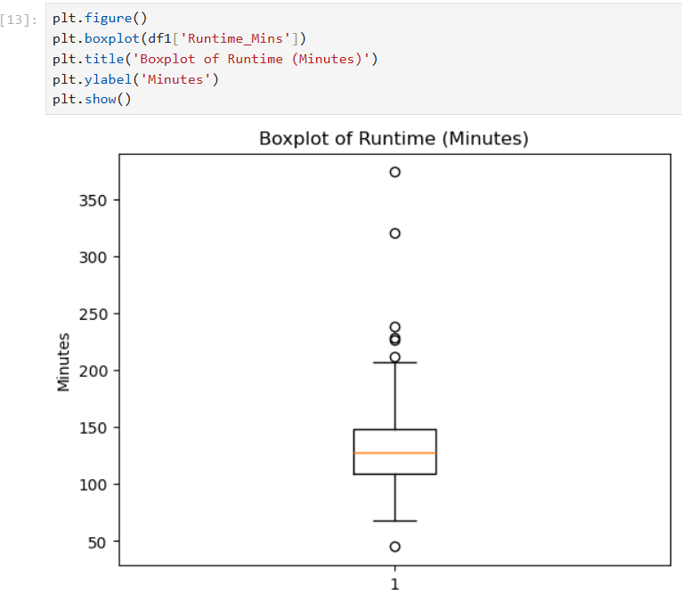
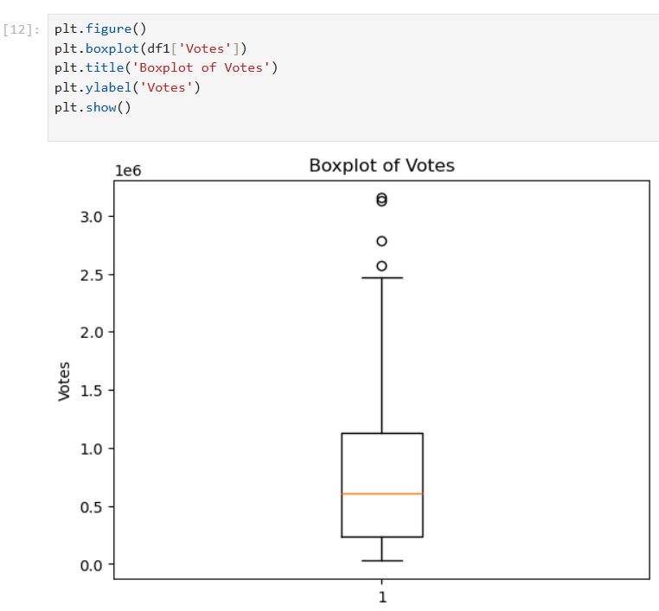
OUTLIER DETECTION
Analysis of Extreme Runtime Values
Analysis of Extreme Vote Values
• Detected extreme runtime values using boxplot
• Identified presence of very long-duration movies
• These represent epic or extended narrative films
• Outliers retained as they reflect real-world movie characteristic
• Runtime variability is relevant to ranking analysis
• Identified extreme vote counts using boxplot
• Observed highly voted movies significantly above average
• Outliers indicate exceptional audience reach
• No vote values were removed to preserve popularity impact
• Vote distribution supports credibility of ranking patterns

Slide 8
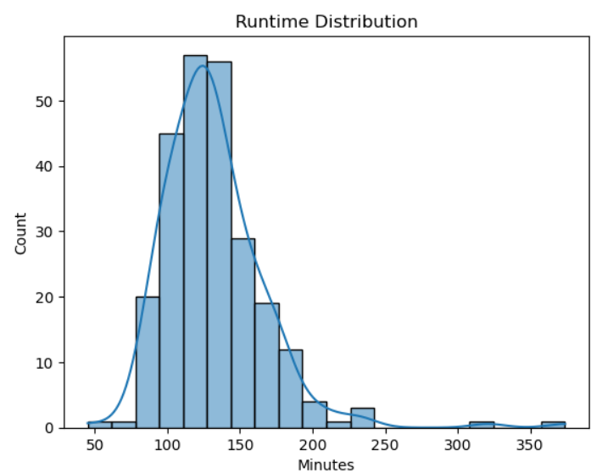
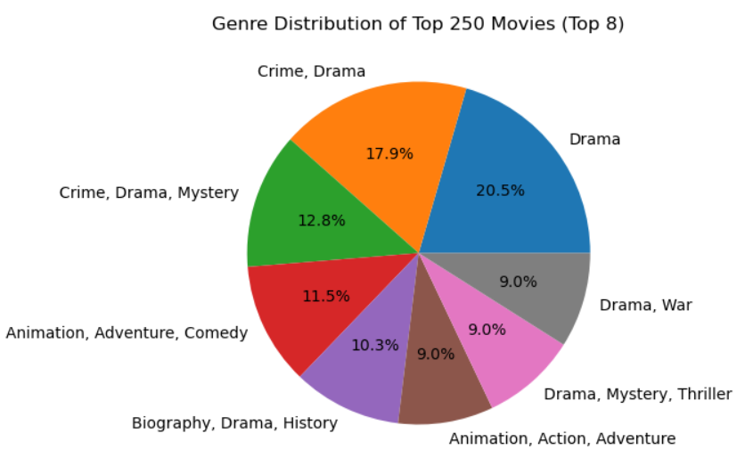
UNIVARIATE ANALYSIS
INTERPRETATION:
Peak: Most movies are 100–150 mins long.
Skew: Right-skewed; a few outliers exceed 300 mins.
INTERPRETATION:
Drama has the highest share in the Top 250.
Crime–Drama is the next most common genre.
Most top movies combine multiple genres rather than one.

Slide 9
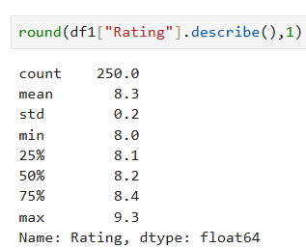
INTERPRETATION:
With a mean of 8.3 and a minimum of 8.0, the dataset consists exclusively of top-rated, "must-watch" films.
A low std of 0.2 shows ratings are tightly clustered around the 8.2 median, indicating very little variation in quality.

Slide 10
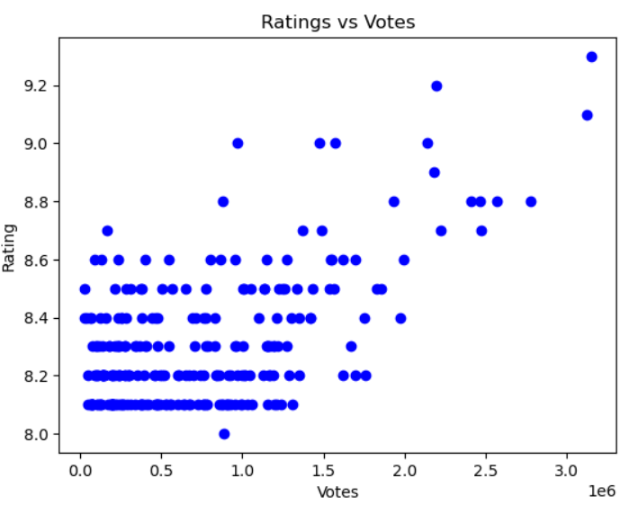
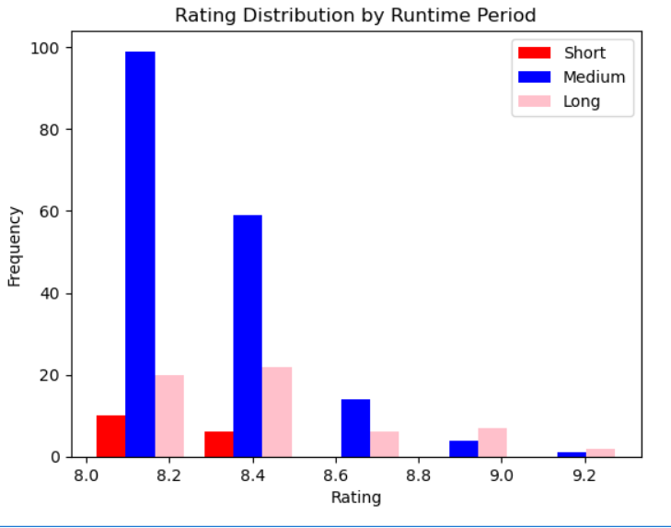
BIVARIATE ANALYSIS
INTERPRETATION:
• More votes slightly correlate with higher ratings.
• Outliers visible: some movies have high votes but moderate ratings.
INTERPRETATION:
• Most movies have ratings clustered 8.0–8.5.
• Medium-length movies slightly dominate higher ratings; short and long movies slightly lower.

Slide 11
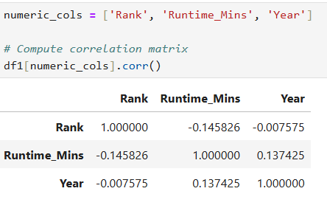
INTERPRETATION:
Rank vs Runtime: correlation ~0 → movie length doesn’t affect ranking.
• Rank vs Year: correlation ~ -0.2 → older movies slightly dominate Top 250.
• Runtime vs Year: correlation ~0 → movie length stable over the years.

Slide 12
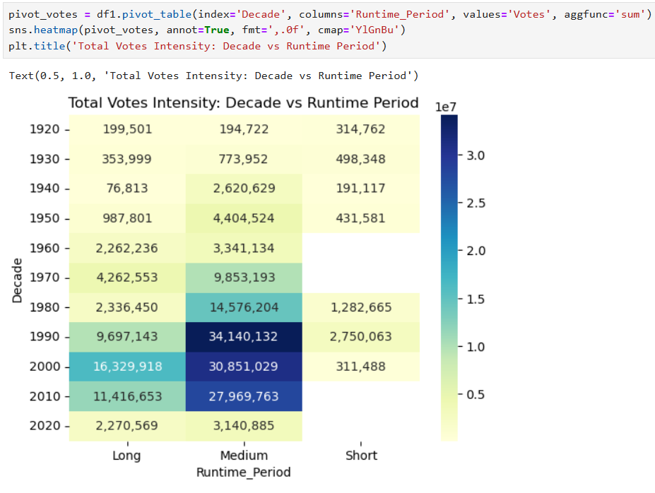
MULTIVARIATE ANALYSIS
In which Decade-Runtime combination are the most Votes concentrated?
INTERPRETATION:
Medium-runtime films (1990s) lead with the highest votes (~34M+).
Voting peaked between 1990–2010, then declined.
Short-runtime content shows consistently low engagement.

Slide 13
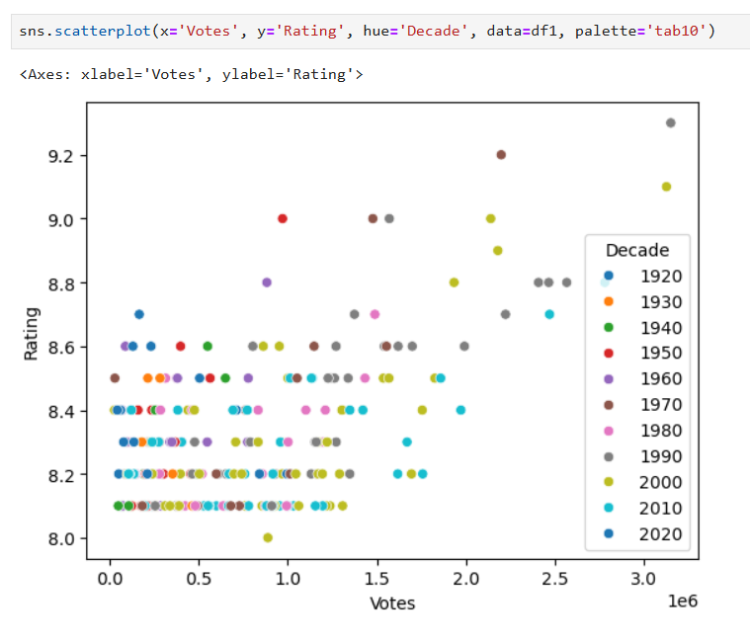
How do Rating, Votes, and Decade interact?
INTERPRETATION:
High ratings generally align with higher votes
Modern films receive more audience votes
Older films have strong ratings but limited reach

Slide 14
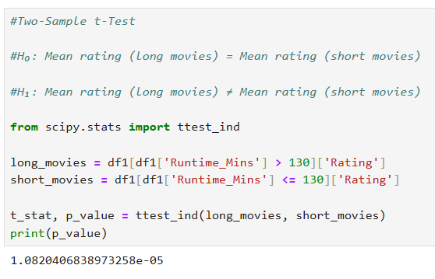
HYPOTHESIS TESTING
Do long movies have significantly higher IMDb ratings than short movies?
INTERPRETATION
p-value = 1.08×10⁻⁵ → Null hypothesis is rejected
There is a significant difference in IMDb ratings between short and long movies
Longer movies generally receive higher audience ratings, indicating preference for deeper storytelling

Slide 15
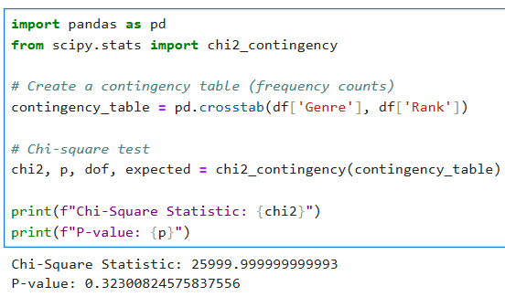
Is there a significant association between a movie's Genre and its Rank Quartile (e.g., do certain genres dominate the top ranks)?
INTERPRETATION
• Chi-Square Test checks if Genre and Rank are independent.
• If p-value < 0.05, reject null → Genre affects Rank.
• If p-value > 0.05, fail to reject null → No significant relationship; Rank is independent of Genre.

Slide 16
KEY INSIGHTS
1. The "Drama" Foundation
• Insight: Drama is the statistically dominant genre, appearing in over 70% of the Top 250 titles.
• Business Impact: While Action or Sci-Fi might drive seasonal box office peaks, Drama provides the most consistent long-term "shelf-life" and critical prestige, making it a lower-risk investment for sustained audience relevance.
Genre Insights
Drama dominates the IMDb Top 250, consistently achieving higher ratings across decades.
Story-driven genres show stronger audience appreciation than action-heavy genres.
Decade Trends
Movies from recent decades receive more votes, reflecting higher audience engagement.
Despite changing eras, average ratings remain stable, indicating consistent quality standards.
Content Analysis
UA / PG-13 certified movies balance wide audience reach with strong ratings.
Flexible content certification does not negatively impact perceived movie quality.
Overall Performance Insight
High ratings are influenced by a combination of genre, content accessibility, and era.
Success in the Top 250 is driven more by storytelling and audience connection than a single factor.
1
2
3
4

Slide 17

RECOMMENDATIONS
Prefer medium to long runtimes for critical recognition
Align movie runtime with genre expectations
Avoid extremely short runtimes for high-ranking goals
Consider audience engagement along with runtime decisions
Use data-driven analysis instead of runtime assumptions

Slide 18
CHALLENGES
• IMDb webpages use dynamic and frequently changing HTML structures, making selector identification difficult
• Inconsistent or missing HTML elements required additional checks during data extraction
• Content rating values were inconsistent and contained missing entries, requiring standardization and mapping
• Vote counts were highly skewed, making direct analysis difficult without transformation
• Selecting clear and non-repetitive EDA visualizations while maintaining analytical relevance was challenging

Slide 19

CONCLUSION
Movie runtime has minimal direct impact on ratings, though medium-length films (90–150 mins) are slightly preferred. Drama and Adventure movies perform best at moderate runtimes, while extremely short or long films receive lower ratings. Popularity (Votes) and release year influence rankings more than runtime. Overall, runtime should guide content planning alongside genre and popularity, not as the sole factor.

Slide 20


THANK YOU !

